Slide 1
Signal Processing First
Lecture 9
D-to-A Conversion
© 2003, JH McClellan & RW Schafer

Slide 2
READING ASSIGNMENTS
This Lecture:
  Chapter 4: Sections 4-4, 4-5
Other Reading:
  Recitation: Section 4-3 (Strobe Demo)
  Next Lecture: Chapter 5 (beginning)
© 2003, JH McClellan & RW Schafer

Slide 3
LECTURE OBJECTIVES
FOLDING: a type of ALIASING
DIGITAL-to-ANALOG CONVERSION is
  Reconstruction from samples
    SAMPLING THEOREM applies
  Smooth Interpolation
Mathematical Model of D-to-A
  SUM of SHIFTED PULSES
    Linear Interpolation example
© 2003, JH McClellan & RW Schafer

Slide 4
SIGNAL TYPES
A-to-D
    Convert x(t) to numbers stored in memory
D-to-A
    Convert y[n] back to a “continuous-time” signal, y(t)
    y[n] is called a “discrete-time” signal
x(t)
A-to-D
x[n]
COMPUTER
y[n]
D-to-A
y(t)
© 2003, JH McClellan & RW Schafer

Slide 5
D-to-A Reconstruction
x(t)
A-to-D
x[n]
COMPUTER
y[n]
D-to-A
y(t)
Create continuous y(t) from y[n]
  IDEAL
    If you have formula for y[n]
  Replace n in y[n] with f_{s}t
  y[n] = Acos(0.2πn+φ) with f_{s} = 8000 Hz
  y(t) = Acos(2π(800)t+φ)
© 2003, JH McClellan & RW Schafer

Slide 6
D-to-A is AMBIGUOUS !
ALIASING
  Given y[n], which y(t) do we pick ? ? ?
  INFINITE NUMBER of y(t)
    PASSING THRU THE SAMPLES, y[n]
  D-to-A RECONSTRUCTION MUST CHOOSE ONE OUTPUT
RECONSTRUCT THE SMOOTHEST ONE
  THE LOWEST FREQ, if y[n] = sinusoid
© 2003, JH McClellan & RW Schafer

Slide 7
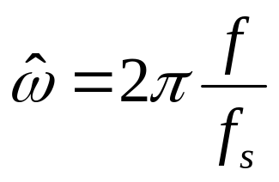
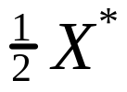



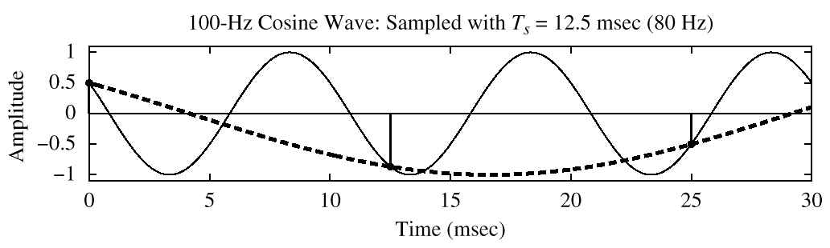
SPECTRUM (ALIASING CASE)
–2.5π
–1.5π
–0.5π
0.5π
1.5π
2.5π
© 2003, JH McClellan & RW Schafer

Slide 8
Reconstruction (D-to-A)
CONVERT STREAM of NUMBERS to x(t)
“CONNECT THE DOTS”
INTERPOLATION
INTUITIVE,
conveys the idea
y[k]
y(t)
t
kT_{s}
(k+1)T_{s}
© 2003, JH McClellan & RW Schafer

Slide 9
SAMPLE & HOLD DEVICE
CONVERT y[n] to y(t)
  y[k] should be the value of y(t) at t = kT_{s}
  Make y(t) equal to y[k] for
    kT_{s} -0.5T_{s} < t < kT_{s} +0.5T_{s}
y[k]
STAIR-STEP
APPROXIMATION
y(t)
t
kT_{s}
(k+1)T_{s}
© 2003, JH McClellan & RW Schafer

Slide 10
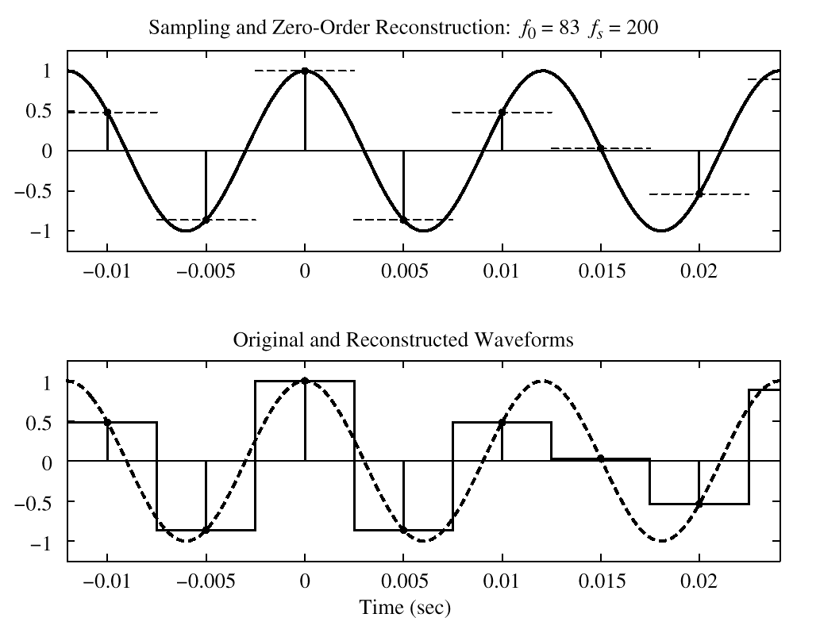
SQUARE PULSE CASE
© 2003, JH McClellan & RW Schafer

Slide 11
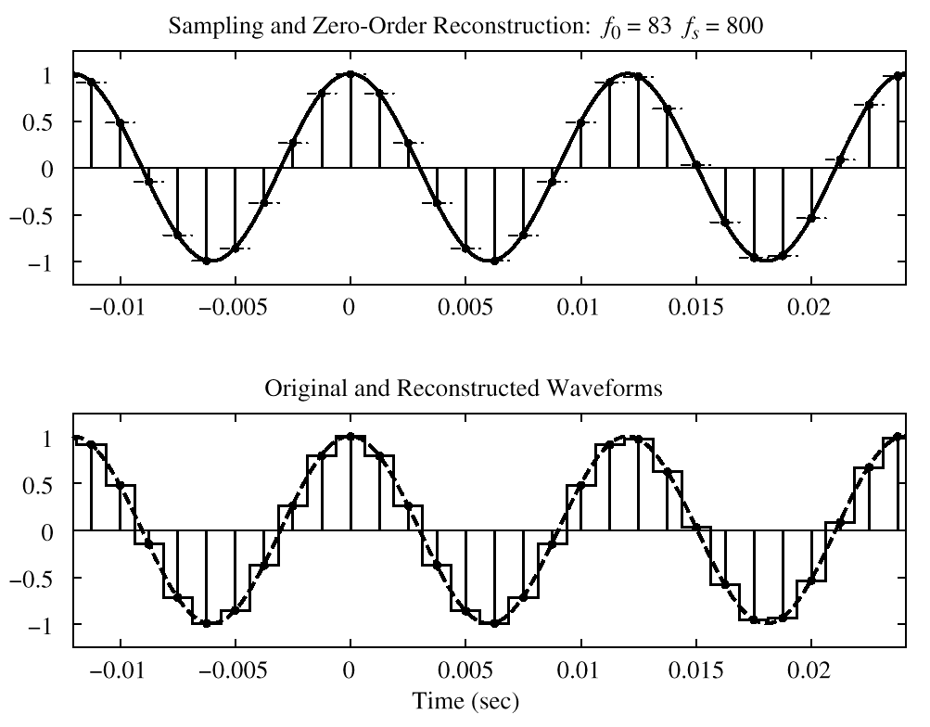
OVER-SAMPLING CASE
EASIER TO RECONSTRUCT
© 2003, JH McClellan & RW Schafer

Slide 12
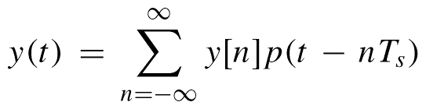
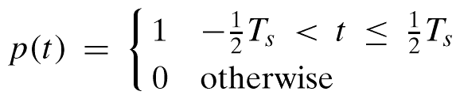
MATH MODEL for D-to-A
SQUARE PULSE:
© 2003, JH McClellan & RW Schafer

Slide 13
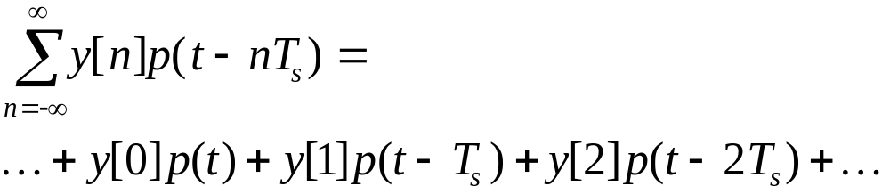
EXPAND the SUMMATION
SUM of SHIFTED PULSES p(t-nT_{s})
  “WEIGHTED” by y[n]
  CENTERED at t=nT_{s}
  SPACED by T_{s}
    RESTORES “REAL TIME”
© 2003, JH McClellan & RW Schafer

Slide 14
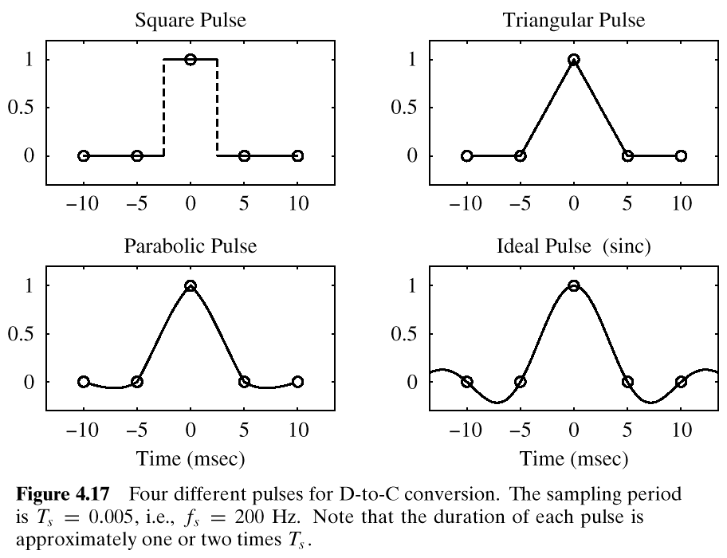
p(t)
© 2003, JH McClellan & RW Schafer

Slide 15
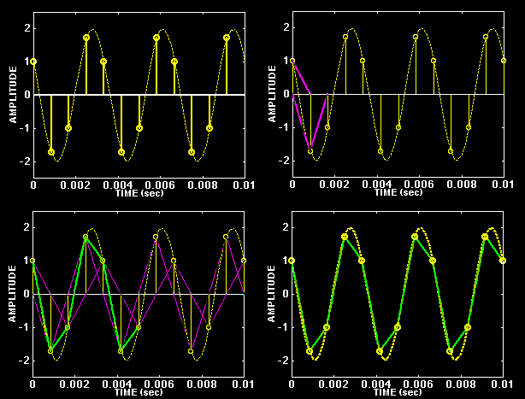
TRIANGULAR PULSE (2X)
© 2003, JH McClellan & RW Schafer

Slide 16
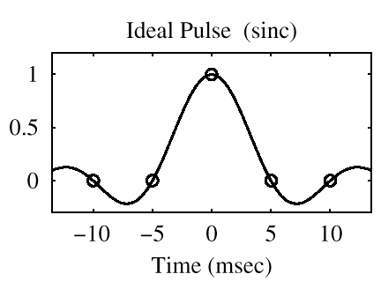
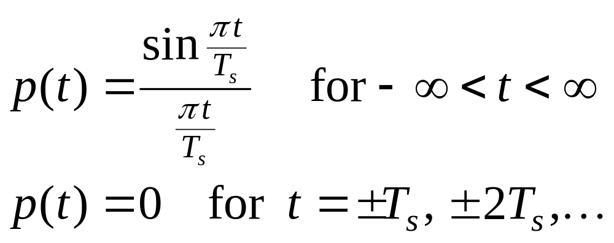
OPTIMAL PULSE ?
CALLED
“BANDLIMITED
INTERPOLATION”
© 2003, JH McClellan & RW Schafer

